Slide 1
Designing info-graphics for web applications
OPN04
Des Traynor
UX Lead
Contrast

Slide 3
Des Traynor
@destraynor
User Experience Lead at Contrast

Slide 4
CONTRAST
www.contrast.ie

Slide 6
INTRO

Slide 7
INTRO
A background on visualisations

Slide 8
Better than text
Adaptable
IT’S HARD TO MAKE VISUALS…
Useful
Meaningful
Readable

Slide 9
Be clear first and clever second. If you have to throw one of those out, throw out clever.
- Jason Fried
“

Slide 10
VISUALS CAN CONFUSE

Slide 11
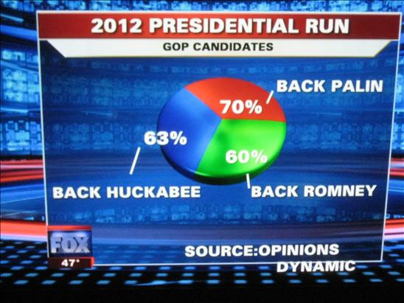

Slide 12
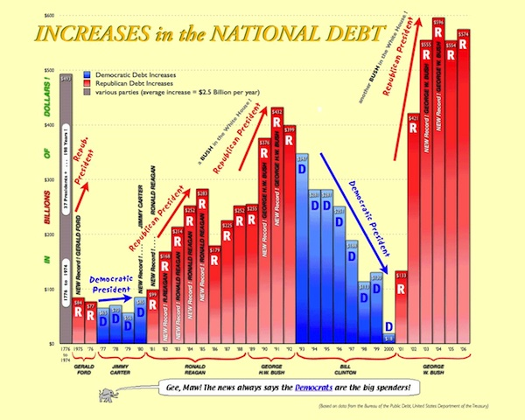

Slide 13
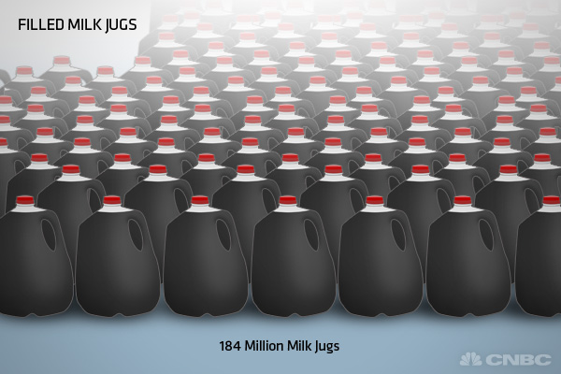

Slide 14
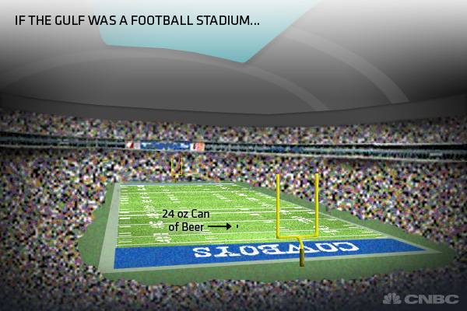

Slide 15
If the Gulf of Mexico - the 7th largest body of water in the world, containing approximately 660 quadrillion gallons of water (that's 660 with 15 zeros) - was represented by Cowboys Stadium in Dallas - the largest domed stadium in the world - how would the spill stack up? In this example, the amount of oil spilled - if the Gulf of Mexico was the size of Cowboys Stadium - would be about the size of a 24 ounce can of beer. Cowboys stadium has an internal volume of approximately 104 million cubic feet, compared to the just over 50 cubic inches of volume in a 24-ounce can. Just like the can, the spilled oil represents only .00000002788% of the liquid volume present in the Gulf of Mexico, although as the oil is dispersed, the amount of water affected becomes substantially greater.

Slide 16
If the Gulf of Mexico - the 7th largest body of water in the world, containing approximately 660 quadrillion gallons of water (that's 660 with 15 zeros) - was represented by Cowboys Stadium in Dallas - the largest domed stadium in the world - how would the spill stack up? In this example, the amount of oil spilled - if the Gulf of Mexico was the size of Cowboys Stadium - would be about the size of a 24 ounce can of beer. Cowboys stadium has an internal volume of approximately 104 million cubic feet, compared to the just over 50 cubic inches of volume in a 24-ounce can. Just like the can, the spilled oil represents only .00000002788% of the liquid volume present in the Gulf of Mexico, although as the oil is dispersed, the amount of water affected becomes substantially greater.

Slide 17
The “anti-infographic movement”
No data was harmed in the making of these info-graphics

Slide 18
KNOW YOUR
AUDIENCE

Slide 19
WHO IS THE INFO FOR?
Surprise surprise, the UX dude is talking about knowing your users.

Slide 20
WHAT ROLE?

Slide 21
CEO Level detail
Strategic view
Focus on the long term
High level overview
Simple summary

Slide 22
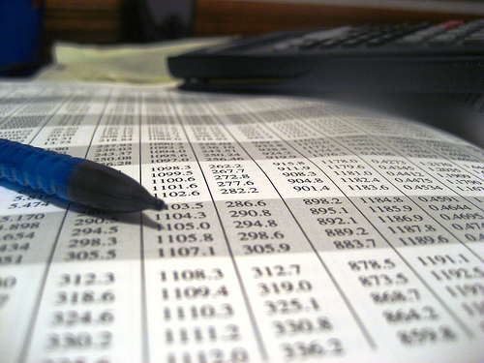
Analyst role
Query driven analysis
Precision required
Emphasis on trends,
and correlations

Slide 23
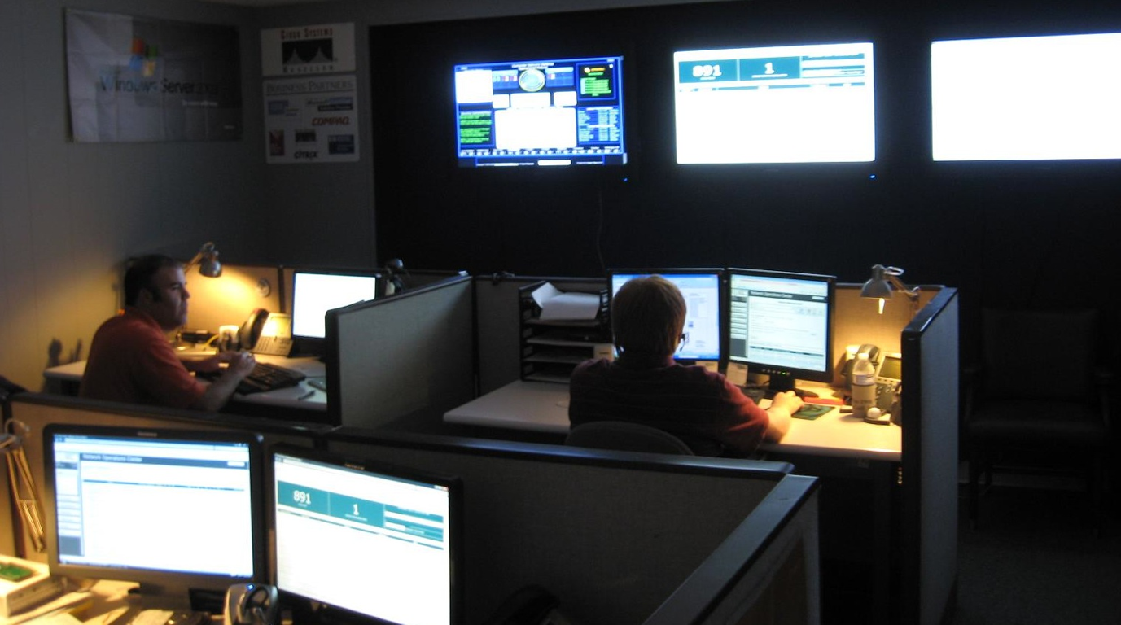
Operations/Logistics
Focus on current status
Issue & Event driven

Slide 24
KNOW YOUR
DOMAIN

Slide 25
WHAT DEPARTMENT?

Slide 26
SALES DEPARTMENT
Leads, conversions, avg. value per sale, etc

Slide 27
MARKETING DEPARTMENT
Impressions, loyalty, awareness, share

Slide 28
NETWORK & IT
Issues, tickets, lead time, open cases, uptime

Slide 29
 | SALES | MARKETING | CUSTOMER SUPPORT
MANAGEMENT |  |  | * Satisfaction Rating * Trend per quarter * Comparison with competitors
ANALYST | * My Active leads * Value per lead * Progress towards target
OPERATIONS |  | * Active campaigns * Current CPM/CPC * Landing page

Slide 30
KNOW YOUR
DATA

Slide 31
# Unit sales
$ Sales today
Avg $ per sale
Us vs Competitor
WHICH OF THESE?
This period vs last period
Avg. $ per customer
Total this month
% Change
in sales
Popular products

Slide 32
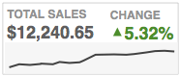
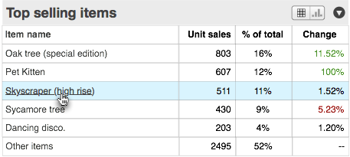
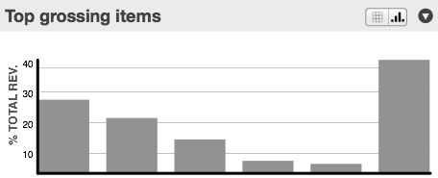

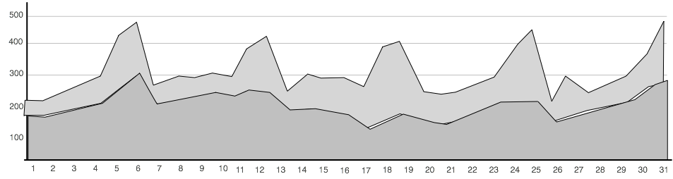
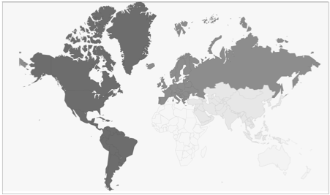
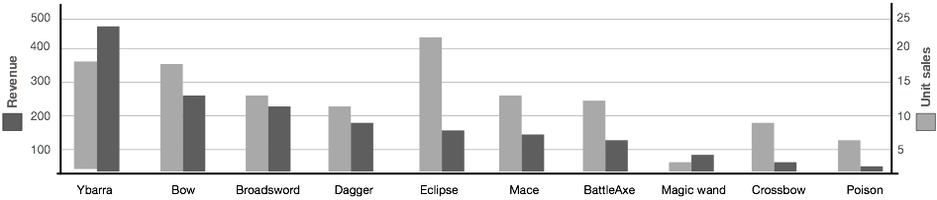
WHICH OF THESE?

Slide 33
6 THINGS TO COMMUNICATE

Slide 34
1.COMMUNICATE SINGLE FIGURE
Used when context is obvious, precision is required, and past/future is irrelevant to user.
Examples:
AA clerk with a waiting list
Checking bank balance
Sys admin checking current status
Notes:
Single numbers can have states (good,bad etc)

Slide 35
2. SINGLE FIGURE WITH CONTEXT
“How are we doing lately? Any problems on horizon?”
Examples:
How were this months sales?
Is the network performing well?
How's our user figures looking?
Notes:
Spark-lines can save space, and provide context

Slide 36
3. ANALYSIS OF A PERIOD
“Show me all the key moments this month”
Examples:
Looking for patterns in longer data sets
Looking ahead based on current data
Comparison with previous period

Slide 37
GOOD LINE CHART
Work best with precise data (e.g. day to day)

Slide 38
BAD LINE CHART
With only 5 data points a line chart can mislead.

Slide 39
BAR CHART
A subtlety different story, with same data

Slide 40
4. ANALYSIS OF PERIOD VS TARGET
“Did we hit our sales figures? Are we fulfilling our 5 9’s quota?
Examples:
Are sales were they should be?
Are all our employees performing okay?
Is our response time better than industry standard?

Slide 41
BAD LINE CHART

Slide 42
A common error in visualisation is leaving all the processing to the reader. At a glance it looks like we’re doing okay here.
In this case, we’re talking about a delta, but we’re not showing the delta...

Slide 43
FOCUS ON THE DELTA
Same data, but different story?

Slide 44
4. BREAKDOWN OF A VARIABLE
“What age groups are buying our stuff? What countries are we big in”
Examples:
Who are our customers?
What's our awareness like in each demographic?
What browsers are people using these days?

Slide 45
BAD PIE CHART
Where are our customers?

Slide 46
ADDING DATA CAN DEFEAT POINT
Oh so America and Spain are the same?

Slide 47
SORTED BAR CHART
Ah, I see.

Slide 48
LYING WITH DIMENSIONS

Slide 49
LYING WITH DIMENSIONS

Slide 50
BAD: AREA PLOT
If you could have just A, or B,C,D and E...

Slide 51
BAD: AREA PLOT
We can see the difference, but we can’t gauge it

Slide 52
BAD UNIT PLOT
Well, let’s see, 8 across, times 3, minus 1, is 23? Yes!

Slide 53
4. BREAKDOWN OF A VARIABLE
“Bar charts aren’t sexy, but they rely on an innate skill, following a line. ”

Slide 54
4. BREAKDOWN OVER TIME
“How has the composition changed over the last year?”
Examples:
How has the browser market changed?
Has our revenue sources shifted recently?

Slide 55
STACKED BAR CHART

Slide 56
STACKED BAR CHART
America peaked in July?

Slide 57
LYING WITH DIMENSIONS
I see lots of yellow there!

Slide 58
LINE CHART OF SAME DATA?

Slide 59
LINE CHART OF SAME DATA?
America on the up. UK never changed?

Slide 60
BAR CHARTS AGAIN?

Slide 61
BAR CHARTS AGAIN?

Slide 62

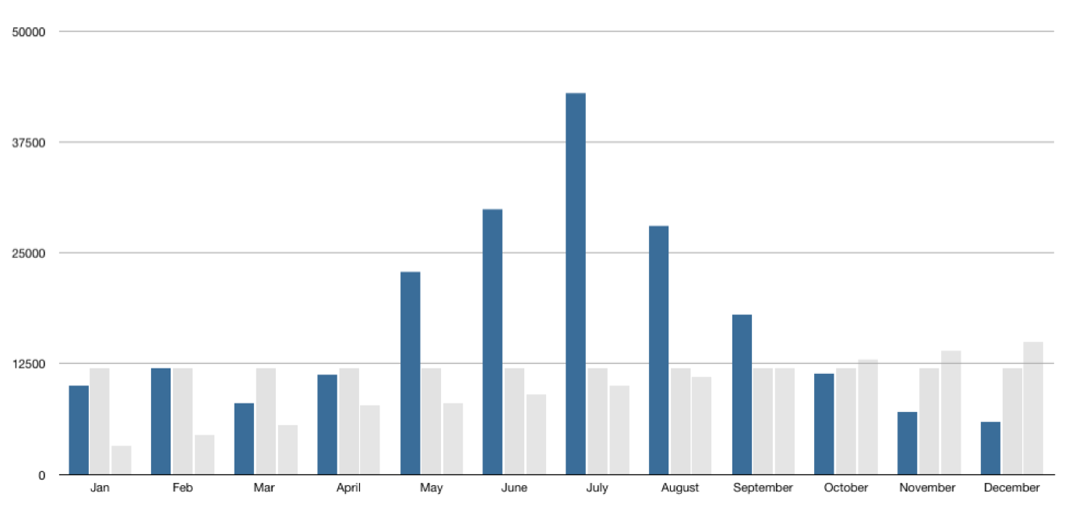
INTERACTIVE, REMEMBER?

Slide 63
STACKED BAR CHART
Why can’t we easily see US growth, or UK stability?

Slide 64

Because we’re not all snooker or pool players.

Slide 65
KNOW YOUR
VISUALS

Slide 66

WAYS TO VISUALISE QUANTITY

Slide 67
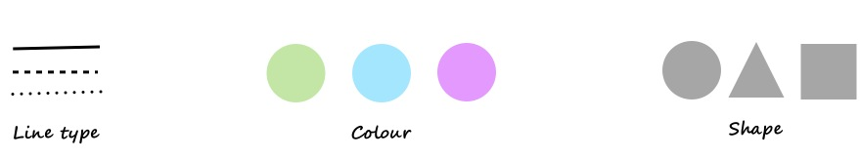
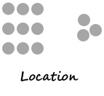
HOW TO VISUALISE CATEGORY

Slide 68
HOW TO USE ALL THIS?
You’ve just taken over a hotel. You’re handed the accounts. Excel hell.
Some good questions to start with?

Slide 69
HOW TO USE ALL THIS?
You’ve just taken over a hotel. You’re handed the accounts. Excel hell.
Q: Are we making money?
Profit is the delta between costs and revenue. Let’s see that for the year.

Slide 70

HOW TO USE ALL THIS?
You’ve just taken over a hotel. You’re handed the accounts. Excel hell.
Q: What’s our core business?
50%
40%
30%
20%
10%
Rooms
Weddings
Bar
Gym/Spa
Restaurant
Businesses
Conferences

Slide 71
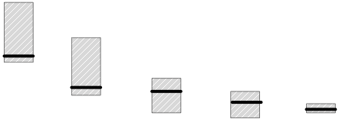
HOW TO USE ALL THIS?
You’ve just taken over a hotel. You’re handed the accounts. Excel hell.
Q: How do rooms sell?
€175
€150
€100
€75
€50
King suite
Junior Suite
Deluxe Room
Standard Room
Hostel

Slide 72
HOW TO USE ALL THIS?
You’ve just taken over a hotel. You’re handed the accounts. Excel hell.
How do we support analyst queries?

Slide 73
KNOW YOUR
STYLE

Slide 74
A WORD ON CONTEXT

Slide 75
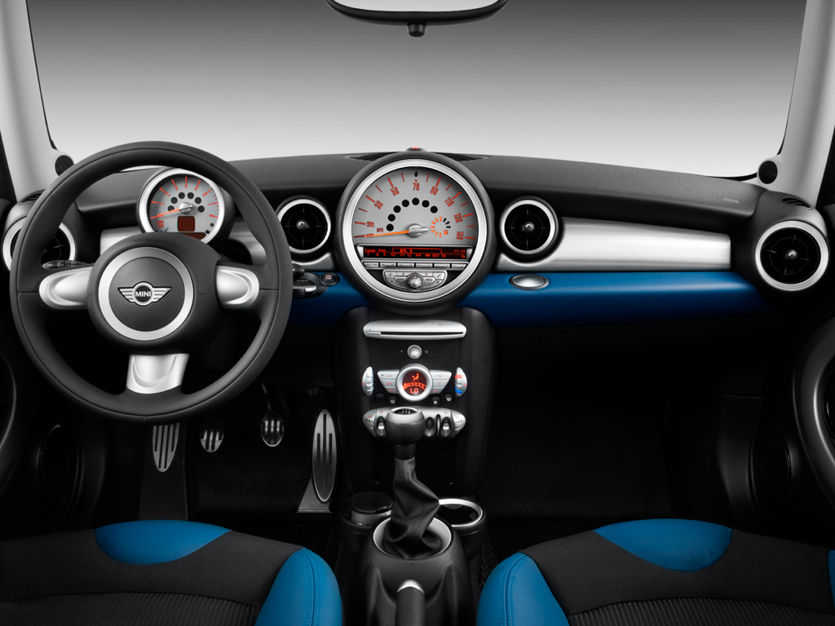
Car.

Slide 76
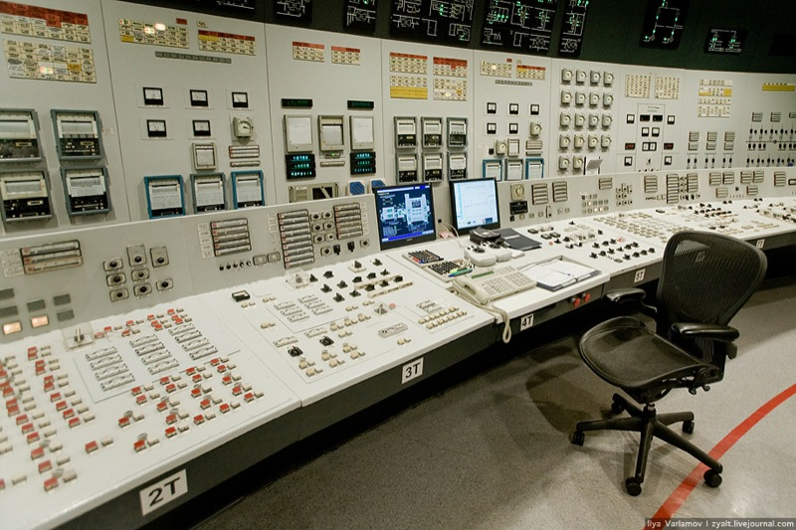
Nuclear power station.

Slide 77
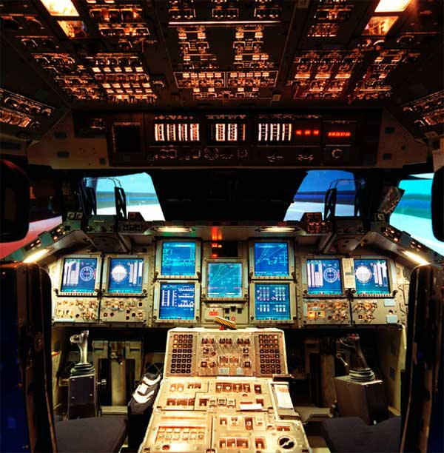
Space shuttle.

Slide 78
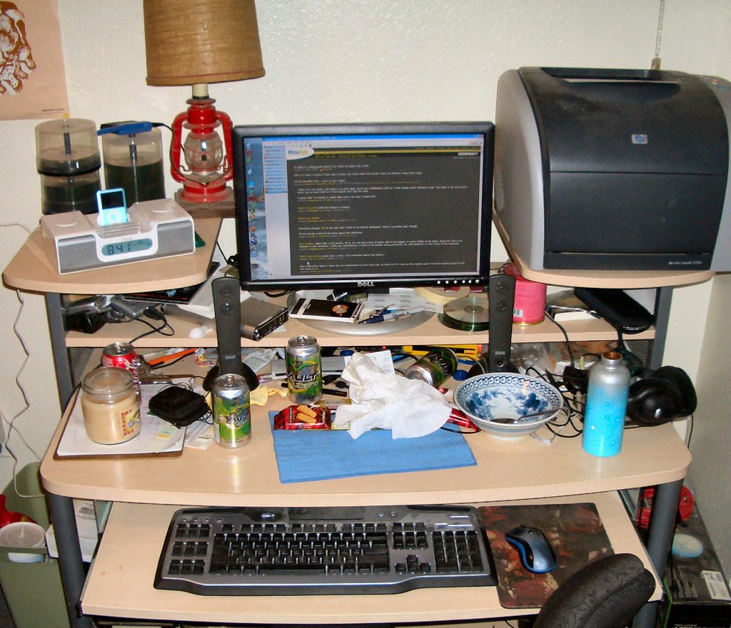
None of those things

Slide 79
STYLING A VISUALISATION
Interfaces aren’t magazines.
We’re not always fighting for impact

Slide 80
“I can’t really design, ya know”
So stop trying :)

Slide 81
Chart junk: the stuff that doesn’t change with the data

Slide 82
X Gradients
X Borders
X Backgrounds
X Shadows
X Gridlines
X Colours

Slide 85
HTML doesn’t has a <strong>
tag but no <weak> tag.
As a result, we forget to
think about what’s less
important on the screen.
Ryan Singer,

Slide 87
Now let’s add in the necessary distinctions

Slide 90
CLOSING
POINTS

Slide 91
1. THEY HAVE TO SAY SOMETHING
The worst visualisations are the ones you look at just think “heh.”

Slide 92
Looks good, but makes very little sense.

Slide 93
2. DASHBOARDS & VISUALS EVOLVE
They only make sense when you have enough data. You don’t need it at the start.

Slide 94
VANITY DASHBOARDS

Slide 95
START WITH THE BASICS

Slide 96
ADD INSIGHT AS YOU NEED IT

Slide 97
ADD A YEARLY VIEW, AFTER A YEAR

Slide 98
INCLUDE INSIGHTS & ACTIONS

Slide 99
CONSIDER ADDING PROJECTIONS

Slide 100
INSIGHTS INTO ENGAGEMENT

Slide 101
INSIGHTS INTO ENGAGEMENT

Slide 102
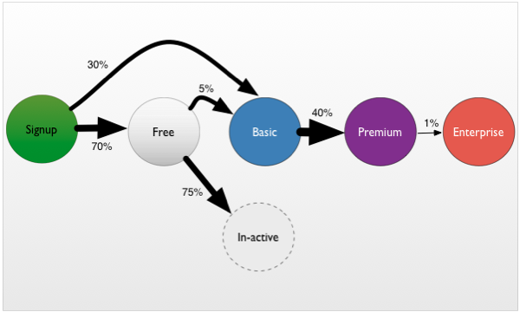
INSIGHTS INTO BUSINESS MODELS

Slide 103
3. A note on usability, impact, and power.

Slide 104
Usability is not everything. If usability engineers designed a nightclub, it would be clean, quiet, brightly lit, with lots of places to sit down, plenty of bartenders, menus written in 18-point sans-serif, and easy-to-find bathrooms. But nobody would be there. They would all be down the street at Coyote Ugly pouring beer on each other.

Slide 105
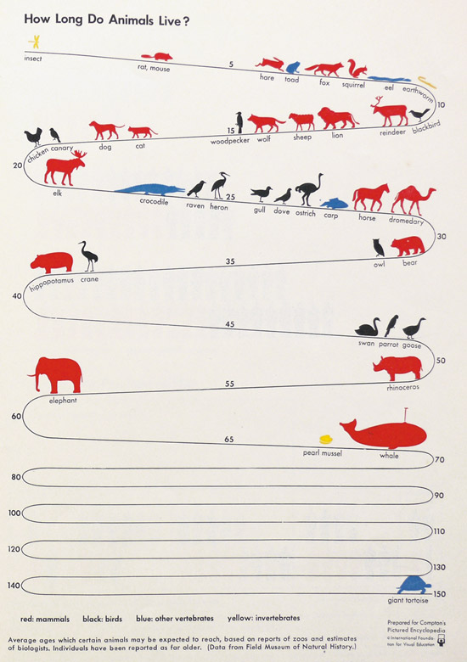

Slide 106
It’s okay to sacrifice a little clarity for emotional impact.

Slide 107
5. We’re not always designing
for first time users.

Slide 108
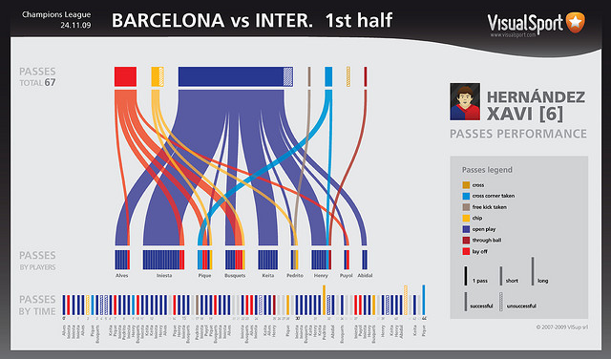

Slide 109
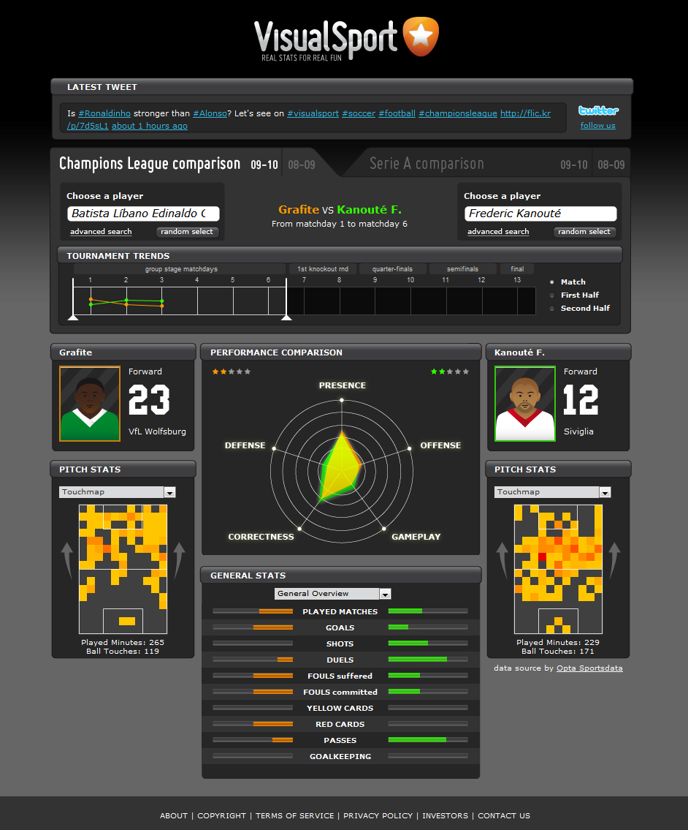

Slide 110
Thank you!
@destraynor
Feedback forms!
des@contrast.ie
contrast.ie/blog

Slide 111

© 2011 Microsoft Corporation. All rights reserved. Microsoft, Windows, Windows Vista and other product names are or may be registered trademarks and/or trademarks in the U.S. and/or other countries.
The information herein is for informational purposes only and represents the current view of Microsoft Corporation as of the date of this presentation. Because Microsoft must respond to changing market conditions, it should not be interpreted to be a commitment on the part of Microsoft, and Microsoft cannot guarantee the accuracy of any information provided after the date of this presentation. MICROSOFT MAKES NO WARRANTIES, EXPRESS, IMPLIED OR STATUTORY, AS TO THE INFORMATION IN THIS PRESENTATION.

